Slide 1

Phishing Awareness Training
Mohamed Taha

Slide 2

Introduction to Phishing
Definition of Phishing
Phishing is a fraudulent attempt to obtain sensitive information such as usernames, passwords, and credit card details by disguising as a trustworthy entity in electronic communication. It's important to recognize the various forms of phishing and the tactics used to perpetuate these attacks to safeguard against them.
Importance of Phishing Awareness
Emphasizing the significance of phishing awareness is vital in today's digital landscape. Employees need to understand the potential risks and consequences of falling victim to phishing attacks. By raising awareness, individuals can actively participate in maintaining a secure work environment.
Goals of the Training
The training aims to equip participants with the knowledge and skills to recognize, prevent, and report phishing attempts. By the end of the training, attendees should feel confident in identifying and avoiding phishing attacks in both corporate and personal contexts.
Photos provided by Unsplash

Slide 3
Common Phishing Techniques
Website Spoofing
Email Phishing
Spear Phishing
Website spoofing involves creating fake websites that mimic genuine ones, with the intention of tricking users into providing personal or financial information.
Email phishing involves sending deceptive emails that appear to be from a legitimate source, aiming to trick recipients into revealing sensitive information or clicking on malicious links.
Spear phishing targets specific individuals, often using personalized information, in an attempt to gain access to confidential data or install malware on the recipient's system.

Slide 4
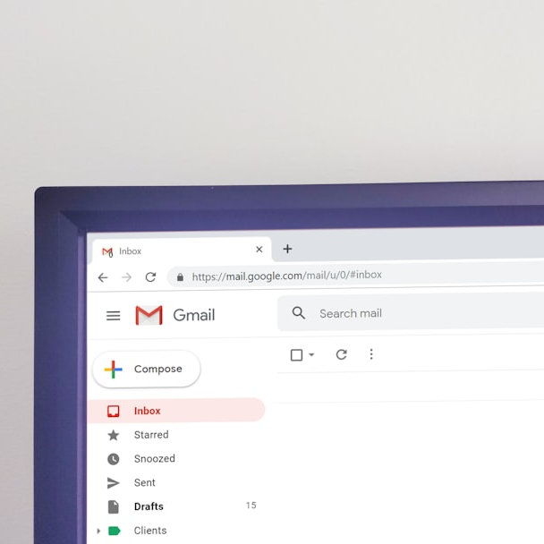
Characteristics of Phishing Emails
Sender Email Address
Phishing emails often use deceptive sender email addresses that may appear similar to legitimate entities, aiming to mislead recipients into believing the email is from a trustworthy source.
Spelling and Grammar Errors
Phishing emails frequently contain noticeable spelling and grammar mistakes, which can serve as red flags to alert recipients of their fraudulent nature.
Urgent Language
Phishing emails often employ urgent or threatening language to create a sense of urgency, pressuring recipients to act quickly without careful consideration.
Photos provided by Unsplash

Slide 5

Identifying Phishing Websites
Check for HTTPS and Padlock Icon
Verify Website URL
Verifying the presence of HTTPS and a padlock icon in the website's address bar serves as an indication of secure and encrypted communication, reducing the risk of falling victim to phishing websites.
Cautiously scrutinizing the website URL for any deviations from the legitimate domain or changes in the spelling can help in identifying potential phishing websites.
Poor Design or Branding Inconsistencies
Phishing websites may exhibit poor design quality or inconsistencies in branding compared to their authentic counterparts, which can serve as indicators of fraudulent websites.

Slide 6
Recognizing Social Engineering Tactics
Building Rapport or Urgency
Attackers employ tactics such as building rapport or creating a false sense of urgency to manipulate individuals into divulging confidential information or taking immediate, unverified actions.
Appealing to Emotions
Phishing attempts may appeal to emotions like fear, curiosity, or greed, leveraging psychological triggers to coax individuals into disclosing sensitive data or performing actions against their better judgment.
Impersonating Authority Figures
Phishing attacks often impersonate authority figures or trusted entities to establish credibility and reduce suspicion while making requests for sensitive information or login credentials.
Photos provided by Unsplash

Slide 7
Best Practices for Avoiding Phishing Attacks
Practice | Description
Think Before Clicking | Always verify the sender and URL before clicking on any links within emails or messages.
Hover Over Links | Hovering over links allows you to preview the destination URL, helping to identify potentially malicious websites.
Never Provide Sensitive Information via Email | Avoid sharing sensitive information, such as passwords or financial details, via email or unsecured channels.
Report Suspicious Emails | Promptly report any suspicious or phishing emails to the IT/security team for investigation and response.

Slide 8
Phishing Simulation Exercises
Examples of Simulated Phishing Emails
Importance of Simulated Phishing Attacks
Benefits of Hands-on Training
By providing examples of simulated phishing emails, participants can familiarize themselves with common attack strategies and improve their ability to discern legitimate correspondence from fraudulent attempts.
Simulated phishing attacks provide hands-on training experiences that realistically emulate potential threats, allowing participants to develop practical skills in recognizing and responding to phishing attempts.
Hands-on training enables participants to actively engage with phishing simulations, enhancing their understanding of real-world tactics and reinforcing the importance of vigilance in identifying suspicious communications.

Slide 9
Conclusion
Recap Key Points
Reinforce the key principles and red flags associated with phishing attacks, ensuring that participants retain essential knowledge to protect themselves and their organizations against potential threats.
Encourage Ongoing Vigilance and Reporting
Promote a culture of continuous vigilance and proactive reporting, underlining the importance of remaining alert to evolving phishing tactics and promptly reporting any suspicious activity.
Thank Participants
Express gratitude to the participants for their attention and commitment to enhancing their awareness and preparedness in countering phishing threats.
Photos provided by Unsplash

